Slide 1
Project 4 – Dunking Data
Machine learning model
Members – Mohamed, Khusayma, Ghelle, Motasim

Slide 2
content
project proposal
data cleaning
machine learning
nba data csv’s
visualization
linear regression
pca
kmeans
matplotlib

Slide 3

Project Proposal
For the final project, the team has decided to have a sport theme in which the data that will be analyzed for machine learning is the stats from athletes from the NBA.
Investigate Win shares and Points per game relations by the use of Linear Regression.
1
Players contribution to games via offensively/Defensively towards the Teams success thought PCA model.
2
3
Dimensional Clustering to visualize any trends of all active player within the 2013-2014 season
Implement a K-means clustering algorithm to cluster players by their performances and team success.
4

Slide 4

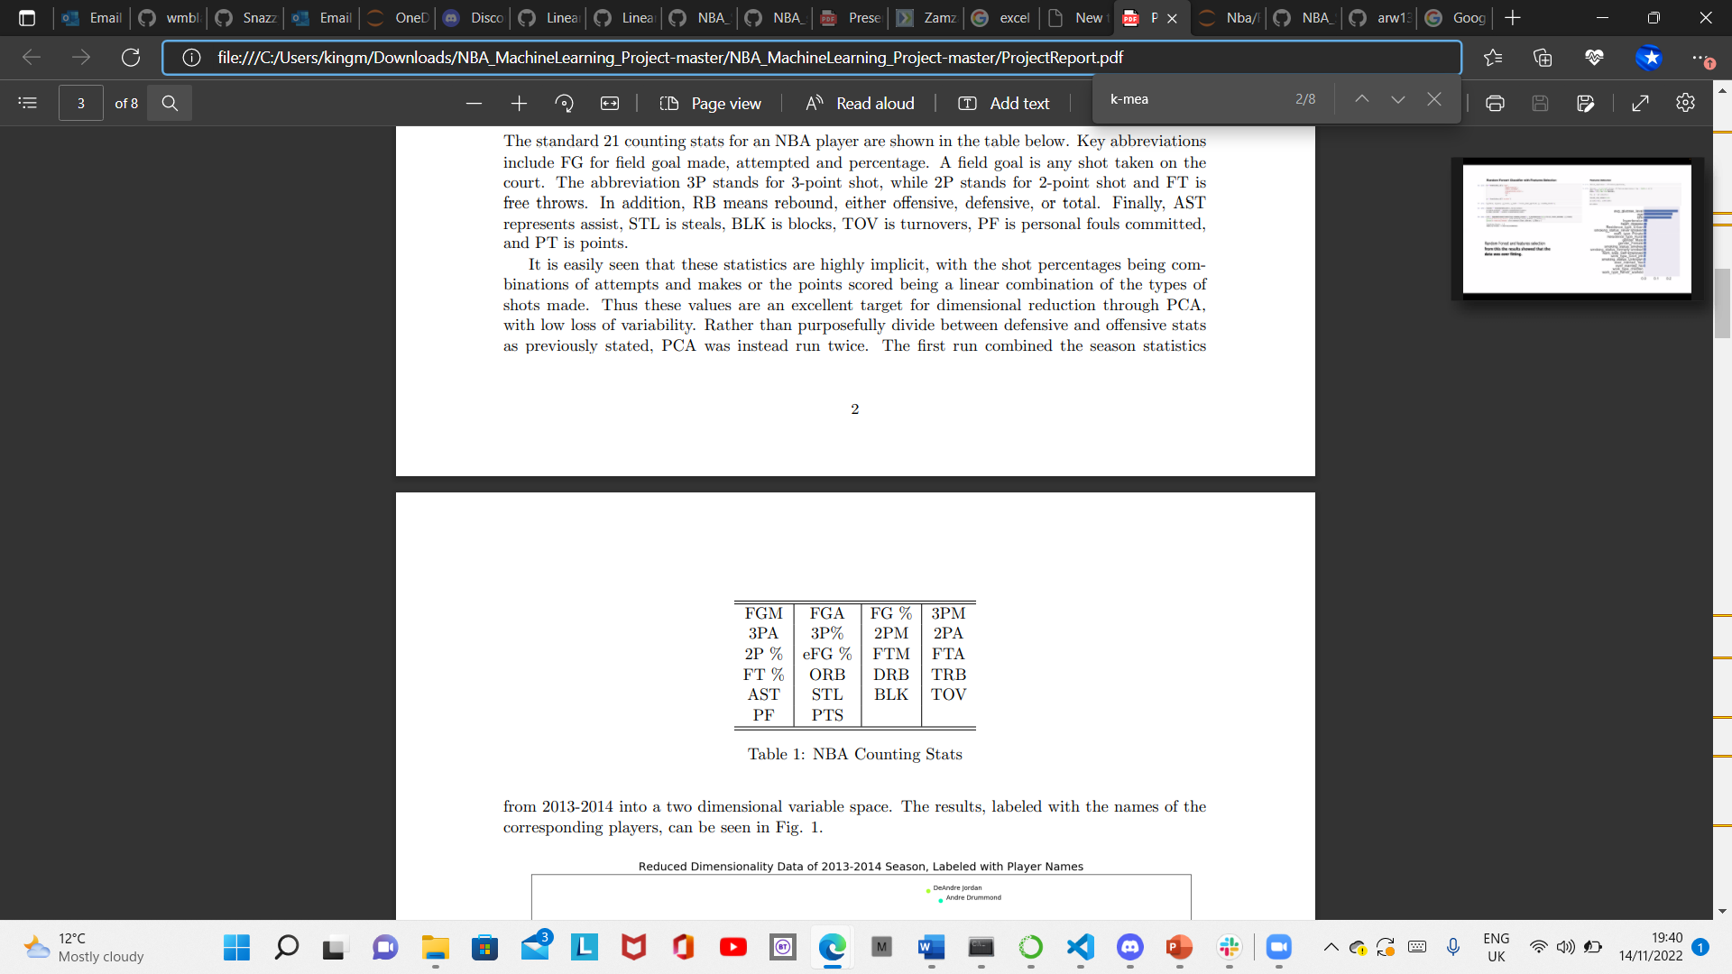



Machine Learning Methodology
Models/Tools
Data
Linear Regression model
K-means
PCA model
K-means
Sklearn
Pandas
Data Sources from Kaggle (Using ESPN Stats from the 2013-2015 Season.
A single season is desirable to anaylse.
Data Source: NBA Players stats since 1950 | Kaggle
Metrics
R^2 to determine model ﬁt.
gaining a 75% accuracy.
Hyperparameters

Slide 5
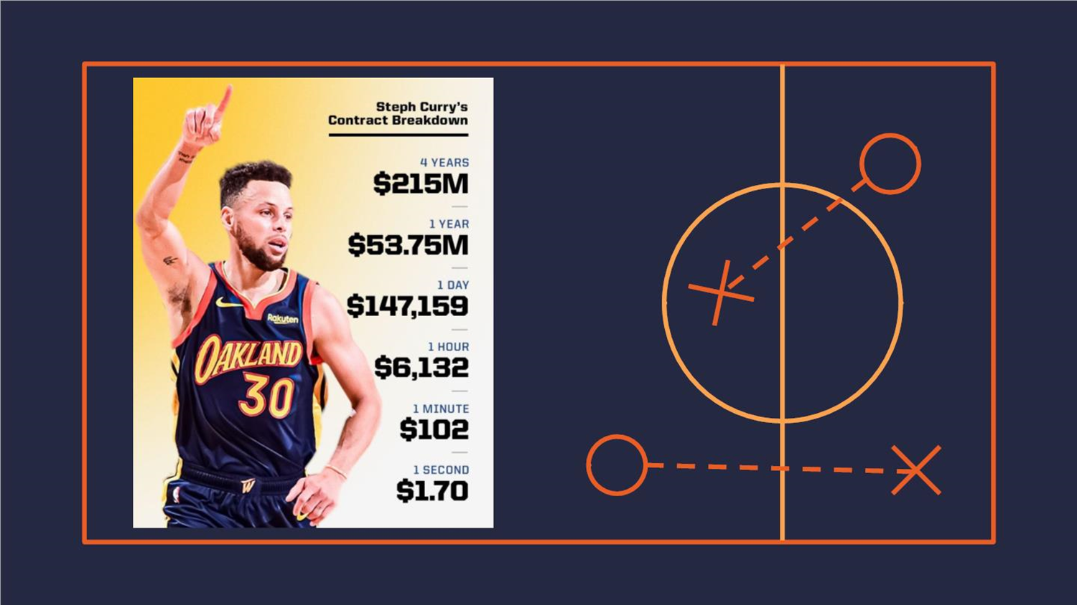
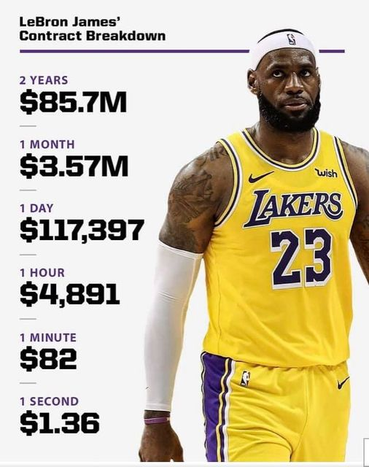
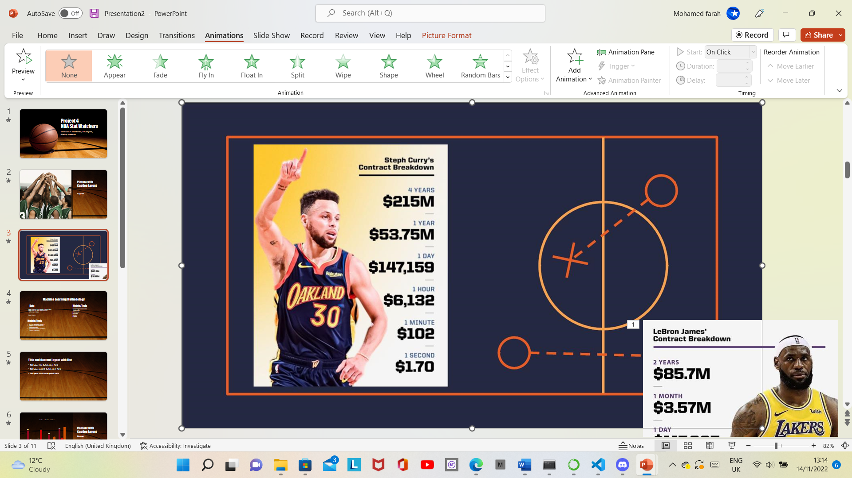
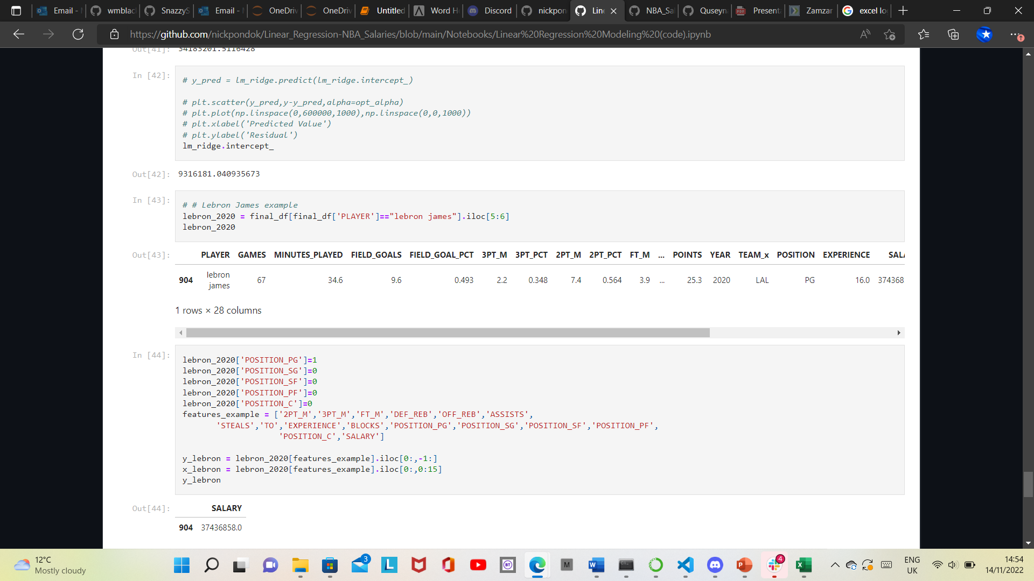
Player Example: Lebron James 2020 Salary vs Stats
Arguably the Best player within the NBA Throughout his 20 year career.
85.7 Million contract signed with LA Lakers in 2020.
Top 10 of all time for Total points scored and Assits made.
PER (Player efficiency effect) of 0.24.
Averaged a 25 points,7.8 assists and 7.7 rebounds.
gained a seasonal win share of 0.54

Slide 6


Data Cleaning!
A wide range of NBA players statistics were gathered. This was obtained from a variety of sources.
When data is gathered, it has impurities and isn’t fit for analysis.
We needed to narrow down the data to exclusively what we are looking for.
To help us avoid information overload, ‘data cleansing’ is the method for this.
This is to help avoid things such as the following; outliers, non-standard values, missing values.

Slide 7
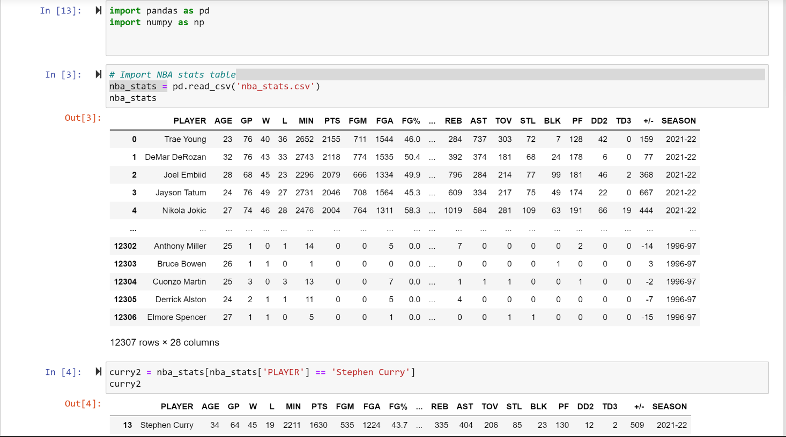

Slide 8
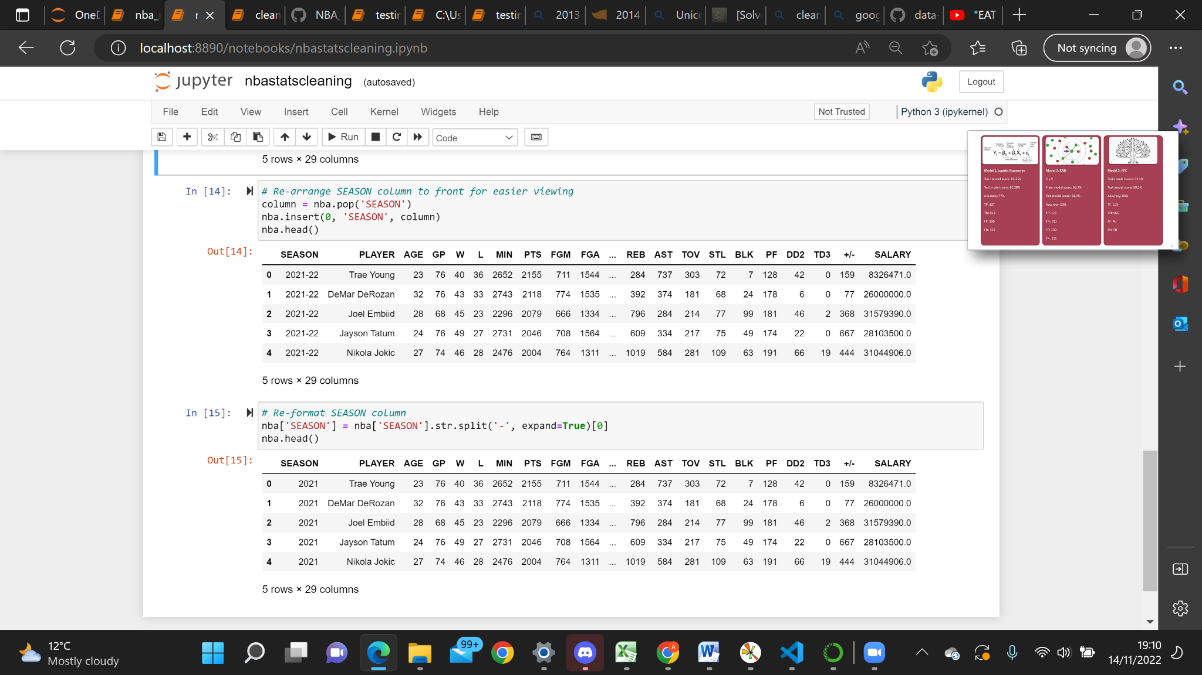

Slide 9
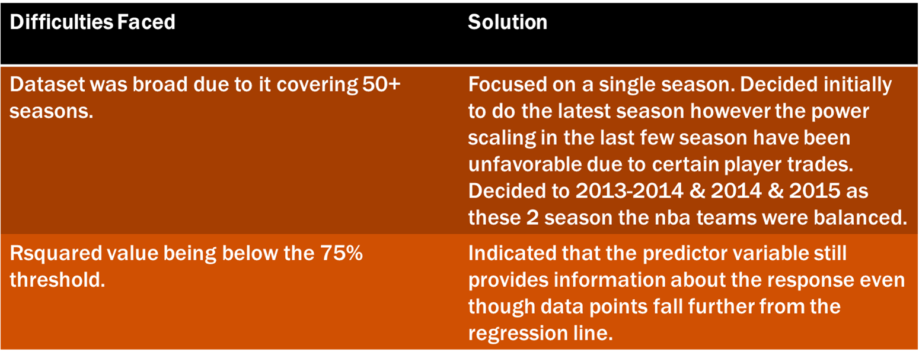
Problematic moments

Slide 10
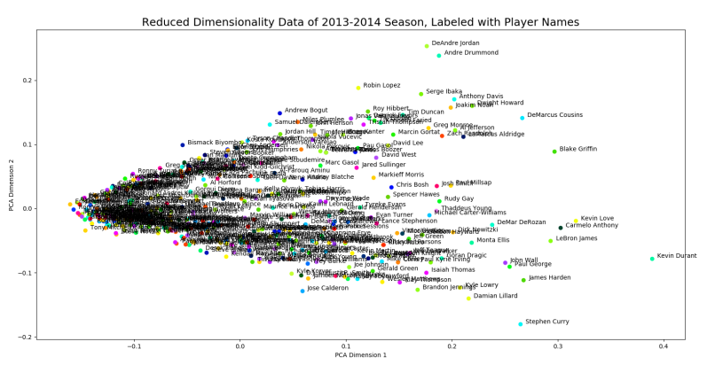
Visualisation (PCA)
PCA dimensions
(Y-Axis) Defensive variables - ( BLK, DEF REB, OFF REB, STL)
(X-Axis) Offensive Variables - ( 2PTS, 3PTS, FTs, PPG)

Slide 11
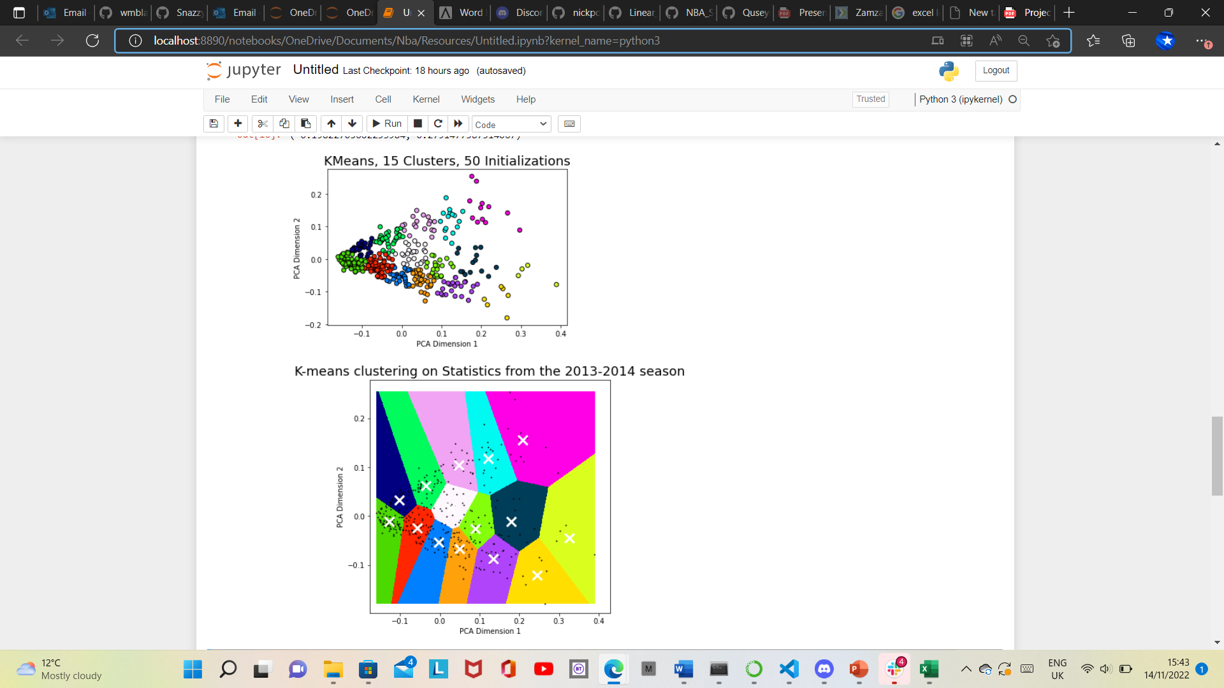
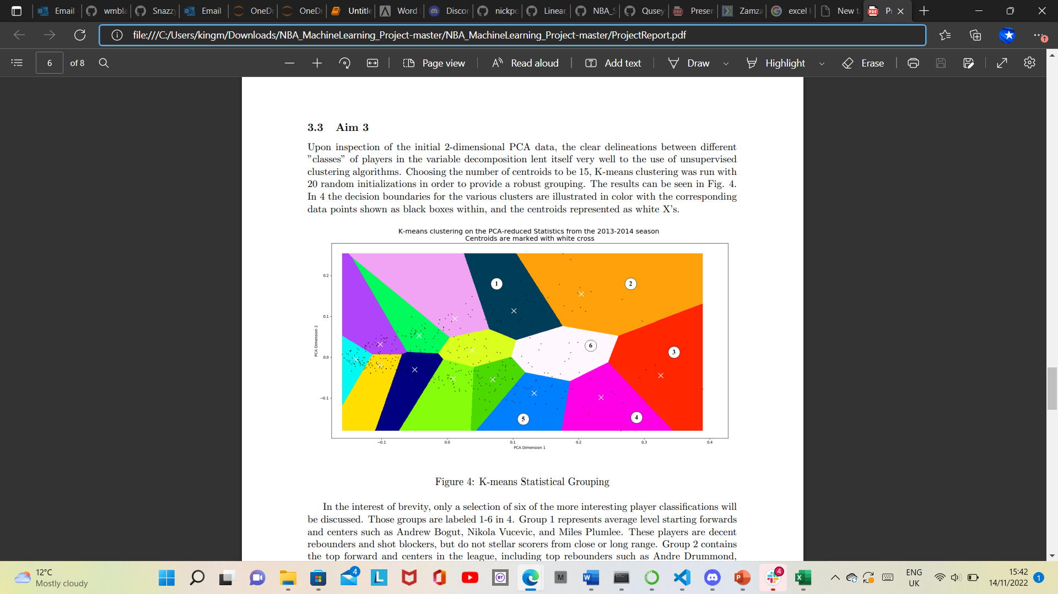
Visualisation (Kmeans)

Slide 12
What are WS (Win Shares) and PTS (per game)?
Win Shares is an advanced stat calculated to quantify exactly how much a player contributes to winning.
How are NBA win shares calculated?
Offensive Win Shares are credited using the following formula: (marginal offense) / (marginal points per win). James gets credit for 424.8 / 30.95 = 13.73 Offensive Win Shares.
Points per game (PTS) refers to the amount of points that a players scores on average in a single basketball game. The way that this number is calculated is by taking the player's total number of points scored and dividing it by their total number of games played.

Slide 13
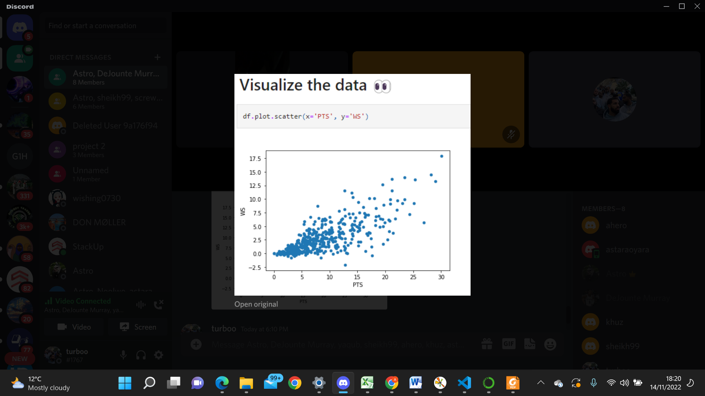
Points x Win shares.
This visualisation displays the positive correlation there is between Points per game (PTS) and Win shares (WS).

Slide 14
Offensive Rebounds and their importance.
A rebound can be grabbed by either an offensive player or a defensive player. Rebounds are divided into two main categories: "offensive rebounds", in which the ball is recovered by the offensive side and does not change possession, and "defensive rebounds", in which the defending team gains possession.
Rebounding is one of the most important aspects of winning games. Offensive rebounding gives your team extra chances, and free throw opportunities, and frustrates the defense. Defensive rebounding is a key part of good defense, limiting the offense to one shot. A good thought is "one shot and out".

Slide 15
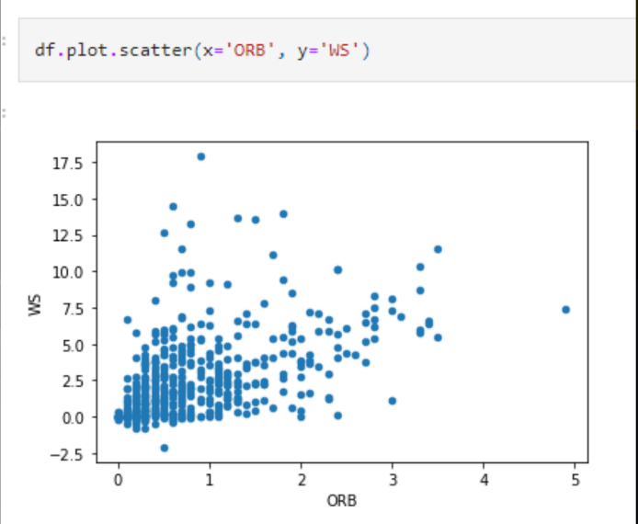
Offensive rebounds x Win shares
This visualisation plots win shares (WS) against Offensive rebound per game (ORB). As you can see there is also a positive correlation between these two variables.
However, the plot is a bit more congested and there aren’t many players who get more than 3 ORB, this is why it's a coveted statistic.
Notes:
But also getting an ORB doesn't guarantee a basket, which is why there isn't a steep positive correlation.

Slide 16
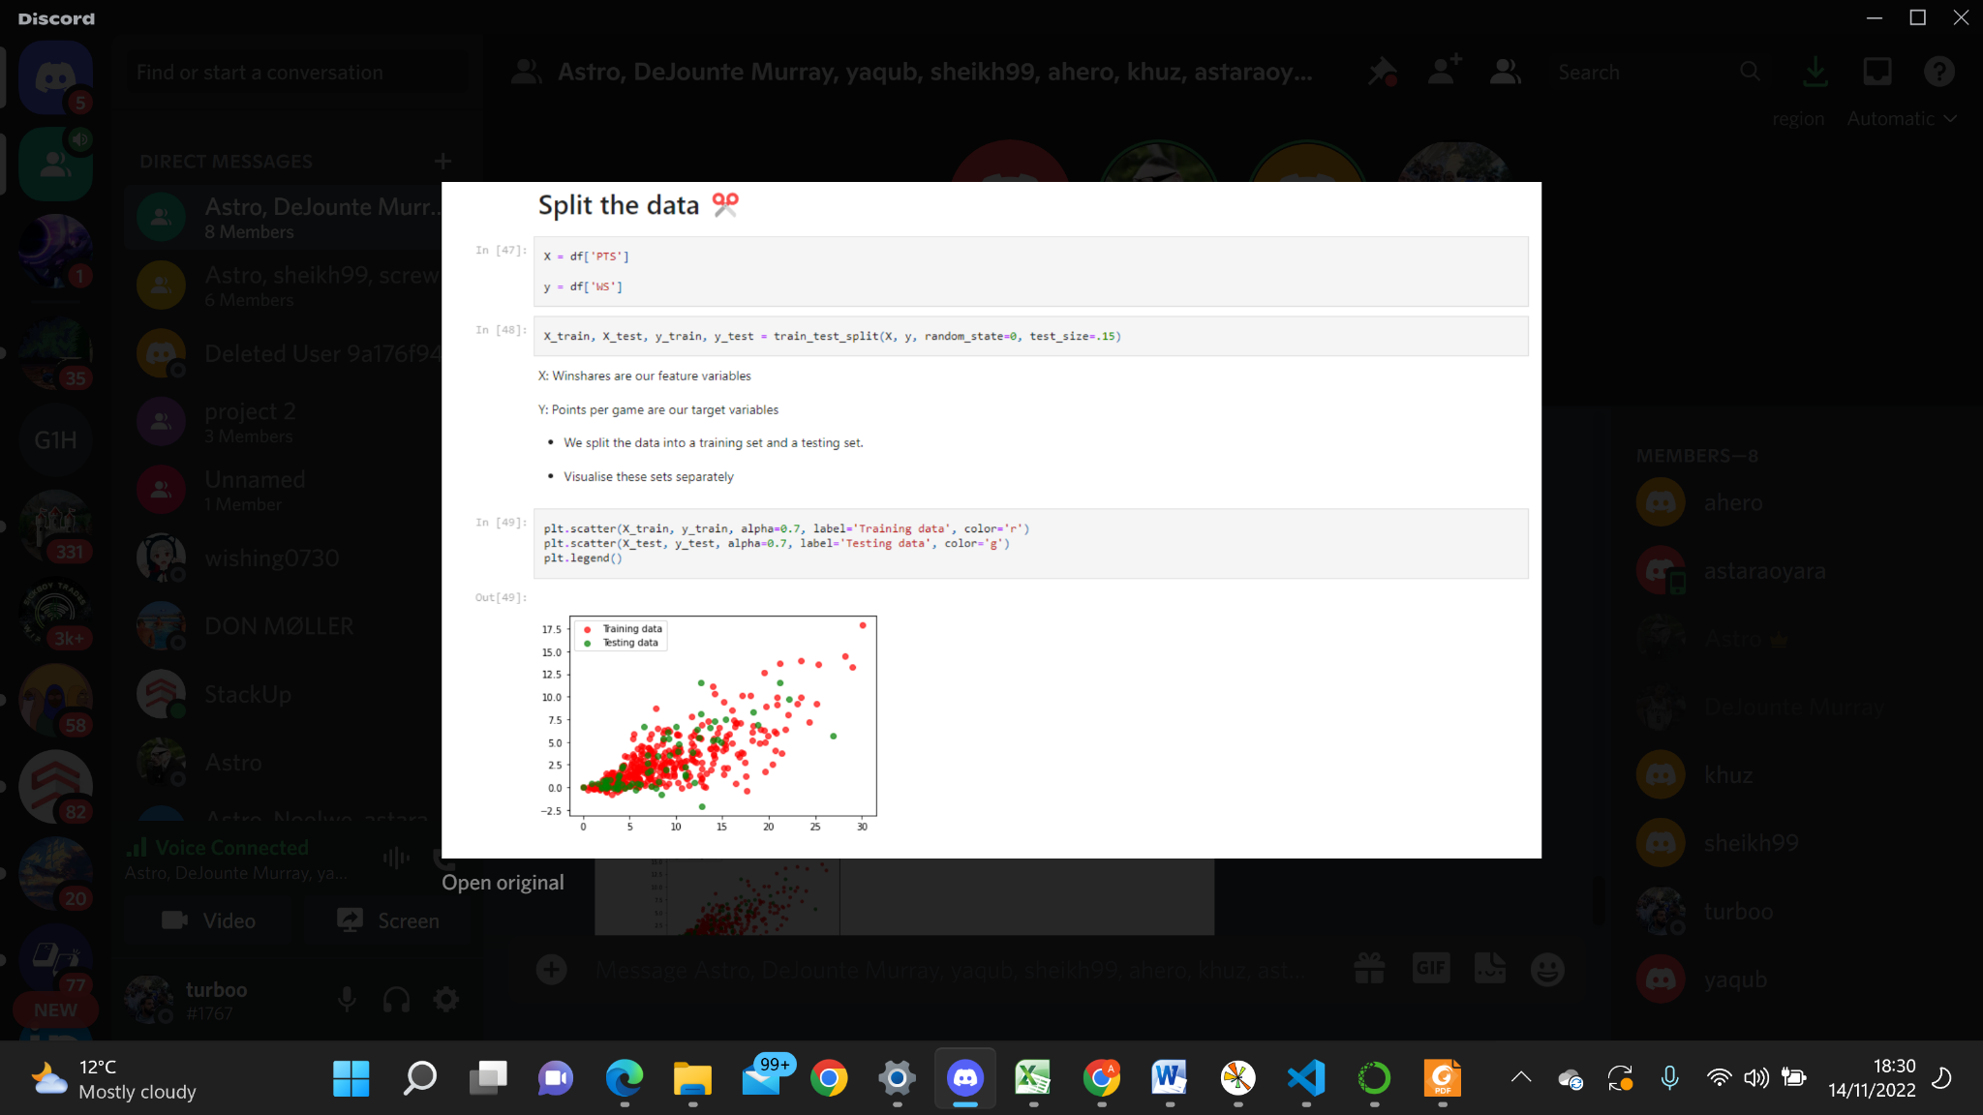
one part is used to evaluate or test the data and the other to train the model.

Slide 17
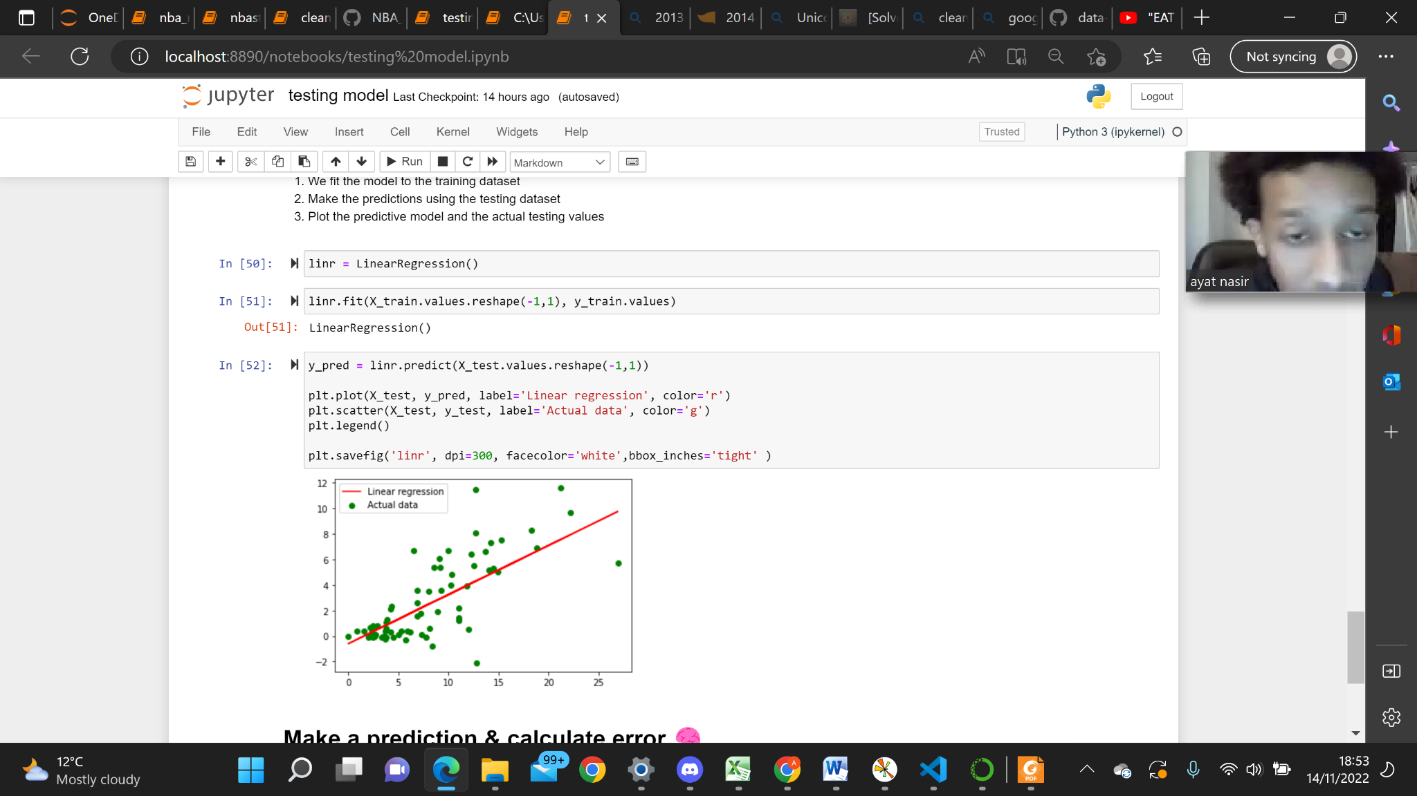
Linear regression.
We have used linear regression, a “model, fit, predict” machine learning method to visualise a clear relationship between points and win shares of these players.
We have created an instance of a model by importing LinearRegression from Sklearn.
We were then able to predict how the players are expected to perform in the future since we have the correlation and a line of best fit.
The same procedure can be done with one of the axis as the years and another as points. This would allow us to simply use the y-intercept of any particular year to get an idea of a players points for that year.
shares
points

Slide 18
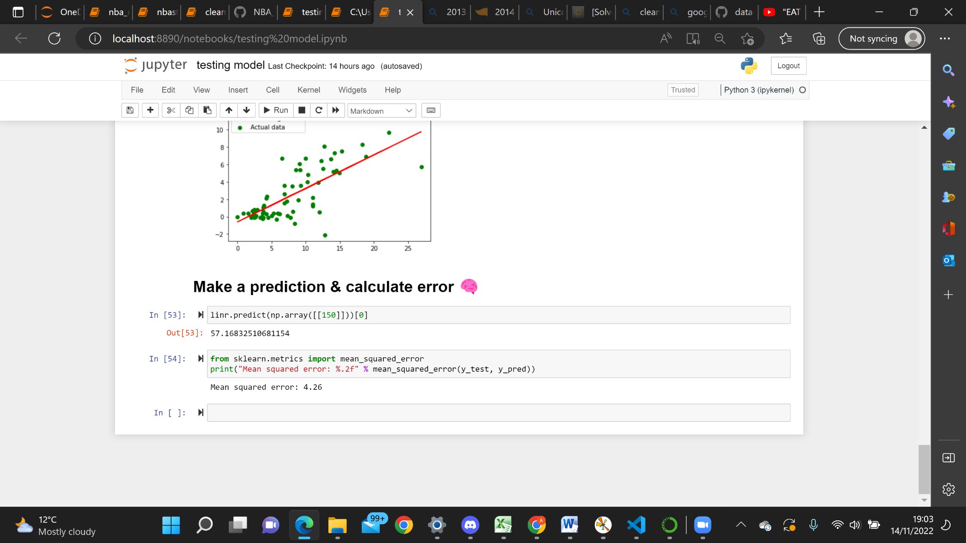
Prediction results.
Mean Squared error (MSE) measures the amount of error in our statistical model.
This is achieved by taking the average, specifically the mean of errors squared from data as it relates to a function.

Slide 19
Findings and reasonings.
Linear relationships of WS with PTS & ORB.
Reasonings.
From our investigations we found there were positive correlation in the relationship between our target variable (Win shares) and both our feature variables Points per game and Offensive rebounds per game.
This drew us to a conclusion that an increase in both these feature variable statistics meant a team won more games in a season.
In our proposal initially, our target season was going to be the 2020-2021 season.
It would be normal for all of you to assume basketball favours height and weight. In this extraordinary season, stephen curry at just 6’3 was the first ever player to win a unanimous MVP and had the highest win shares that season despite not having the highest points per game or even remotely close to a high ORB.

Slide 20
Conclusion
In summary, machine learning can provide valuable inferences on NBA statistical data. While the ability of previous season was proven to be an unsuccessful metric for the prediction of games, studies have found that rather than individual player statistics, the most important predictors for winning include team Win%, offensive efficiency.

